Slide 1

Welcome to Holy Trinity
All Age Holy Communion Service

Slide 2

Welcome
&
Good News

Slide 3
Call to worship
Leader Whoever we are
Whatever we’ve done
All God loves us
Leader When our hands are clean
When our hands are dirty
All God loves us

Slide 4
Call to worship
Leader God tells us to listen to Jesus
All God offers us forgiveness
and a new start

Slide 5
Opening Hymn

Slide 9

Saying Sorry to God.
Sit or Kneel as we pray
Leader We are made in God’s image.
God loves us.
Let us bring ourselves and our concerns to God…

Slide 10
Leader For the people I have hurt
All I’m Sorry
Leader For the mistakes I have made
All I’m Sorry
Leader For the things I didn’t do
All I’m Sorry

Slide 11
Leader For hurting myself
All I’m Sorry
All God of love and mercy,
Forgive me.
Help me to let go of my hurts and regrets.

Slide 12
Leader Jesus said:
“Come to me, you who are heavy laden And I will give you rest.”
Jesus said:
“Your sins are forgiven.
Go and sin no more.”
Jesus said:
“Don’t be afraid, I love you.
Come and follow me.”
All Thanks be to God

Slide 13
God’s forgiveness
Leader Who we were
And what we have done
Is safe with God.
All Who we are now
And who we will become
Is safe with God.

Slide 14
Special Prayer for Today

Slide 15

Bible Reading

Slide 16

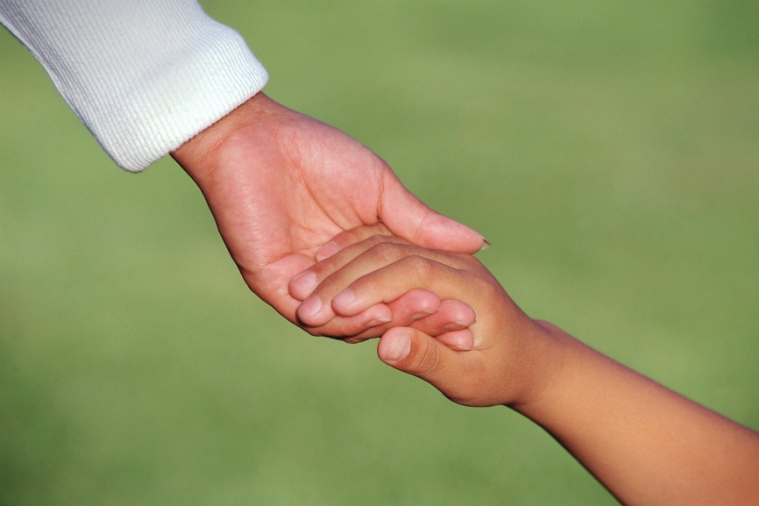
Talk

Slide 17
Song

Slide 18

All We believe in God the Father,
from whom every family
in heaven and on earth is named.
We believe in God the Son,
who lives in our hearts through faith,
and fills us with his love.

Slide 19
All We believe in God the Holy Spirit,
who strengthens us
with power from on high.
We believe in one God;
Father, Son and Holy Spirit.
Amen.

Slide 20
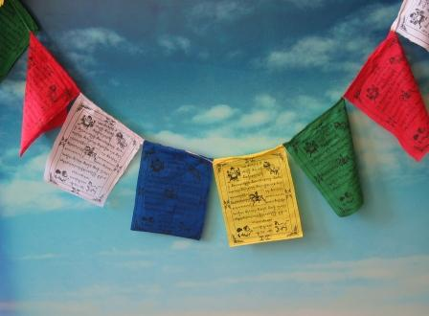
Prayers

Slide 21

The Peace
Leader God calls us to peace:
All in God’s justice is our peace.
Leader Christ calls us to be God’s people:
All in Christ is our peace.
Leader The Peace of the Lord be always with you
All And also with you.

Slide 22
Hymn
During which our offering will be taken

Slide 26

Preparation of the table
All Wise and gracious God,
you spread this table before us;
nourish us with the word of life and the bread of heaven.
Amen

Slide 27
Holy Communion Prayer
Leader The Lord be with you
All And also with you
Leader Lift up your hearts
All We lift them to the Lord
Leader Let us give thanks to the Lord our God
All We lift them to the Lord

Slide 28
Person 1 Why do we give thanks and praise at this table ?
Leader We give thanks for all that God has done for us.
God the Father created the heavens, the earth and everything in them;
and created us in his own image.

Slide 29
All Let us give thanks and praise
Leader Christ our Lord became human like us, and died to save us.
All Let us give thanks and praise.
Leader God sent the Holy Spirit to gather us together as the people of God.
All Let us give thanks and praise.
Leader So come let us join together to worship this God who loves us.

Slide 30
All Holy, holy, holy Lord,
God of power and might,
heaven and earth are full of your glory, hosanna in the highest.
Blessed is he who comes in the name of the Lord.
Hosanna in the highest,
hosanna in the highest.

Slide 31
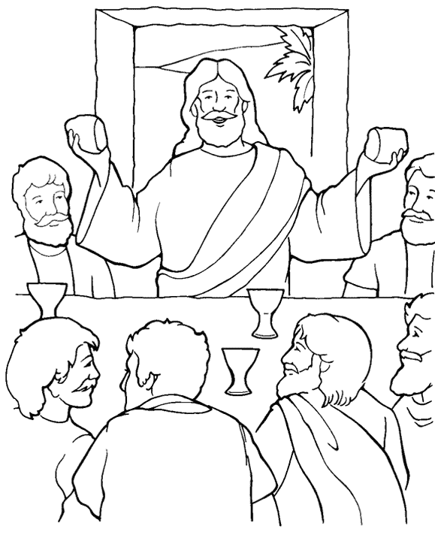
Leader We praise you Father that before Jesus our Saviour died,
he gave us this holy meal.

Slide 32
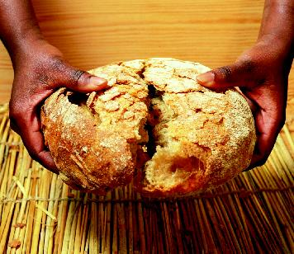
Person 2 Why do we eat bread
together at this table?
Leader On the night before he died,
Jesus took bread.
After giving thanks he broke it,
and gave it to his disciples saying,
"Take, eat. This is my body, given for you.
Do this in remembrance of me."

Slide 33
Person 3 Why do we drink from the cup together at this table?
Leader In the same way,
after supper Jesus took the cup,
saying, "This cup is God's new covenant sealed with my blood,
poured out for you for the
forgiveness of sins.
Do this in remembrance of me."

Slide 34
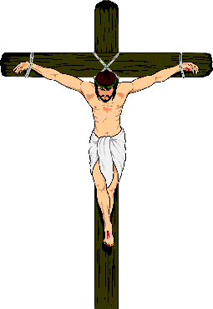
Person 4 What do we remember at this table ?
Leader We remember the Father's
gracious love for us,
Christ's death and resurrection for us, and the Spirit’s tender care for us.

Slide 35
Leader Let us proclaim the mystery of Faith
All Christ has died,
Christ is risen,
Christ will come again.
Leader Merciful Father, pour out your Holy Spirit on us and on these gifts of bread and wine.
All In eating and drinking together may we be made one with Christ and with one another . Amen.

Slide 36
The Lord’s Prayer
Leader As God’s children, and heirs with Christ we cry in the Spirit, ‘Abba’, Father.
All Our Father in heaven,
hallowed be your name,
your kingdom come,
your will be done,
on earth as in heaven.
Give us today our daily bread.

Slide 37
All Forgive us our sins
as we forgive those who sin against us.
Lead us not into temptation
but deliver us from evil.
For the kingdom, the power,
and the glory are yours
now and for ever.
Amen.

Slide 38
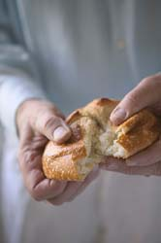
Breaking of the Bread
We break this bread
to share in the body of Christ.
All Though we are many,
we are one body,
because we all share in one
bread.

Slide 39

God’s holy gifts
for God’s holy people.
All Jesus Christ is holy,
Jesus Christ is Lord,
to the glory of God the Father.

Slide 40
Hymns During Communion

Slide 47

Notices

Slide 48
Closing Hymn

Slide 51
Blessing
All God of love, in you we live and move and have our being.
We thank you that through your Son
we are connected to you for ever.
Amen.

Slide 52

Go on stop have a cuppa and a chat and carry on the fellowship.
It’s good to TALK.

